Slide 1
Fake news project
Signal Processing Laboratory
Summer 2018

Slide 2
Data-set : GDELT
Source : https://blog.gdeltproject.org/gdelt-2-0-our-global-world-in-realtime
Date | #Sources | #Articles | #Events
04.12.17 -12.12.17 | 16235 | 782928 | 1462699
Contains
Event ID | Event Date | Mention Date | Source | Article | …

Slide 3
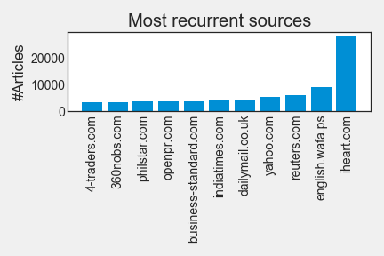
Sources’ recurrence

Slide 4
Most popular sources in the web
Sources : https://www.vodien.com and https://www.alexa.com
yahoo.com | cnn.com | nytimes.com | msn.com | breitbart.com
#Articles
5226 | 539 | 723 | 2197 | 435
Republication rate
57.4 % | 38.4 % | 22.4 % | 51.4 % | 29.4 %
Heaviest links
dailymail.co.uk : 874 trust.org : 642 swissinfo.ch : 582 | kpax.com : 195 channel4000.com : 109 brproud.com : 83 | reuters.com : 21 english.wafa.ps : 15 yahoo.com : 14 | wbt.com : 530 newser.com : 412 omaha.com : 404 | iheart.com : 32 news12.com : 30 omaha.com : 30
Biases (source : https://mediabiasfactcheck.com)
Left-Center Bias | Left Bias | Left-Center Bias | Left-Center Bias | Right-Extreme Bias

Slide 5
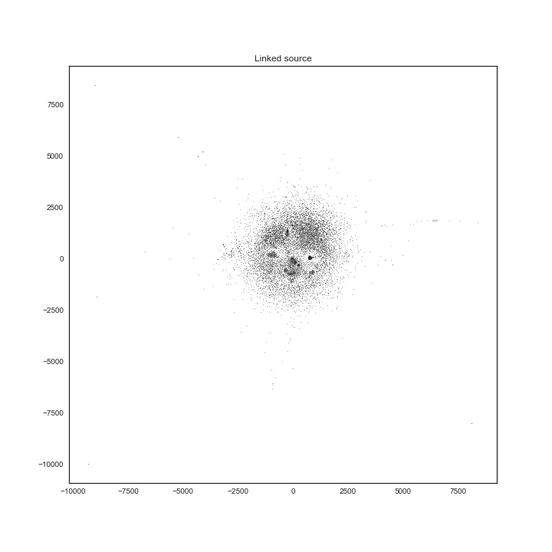
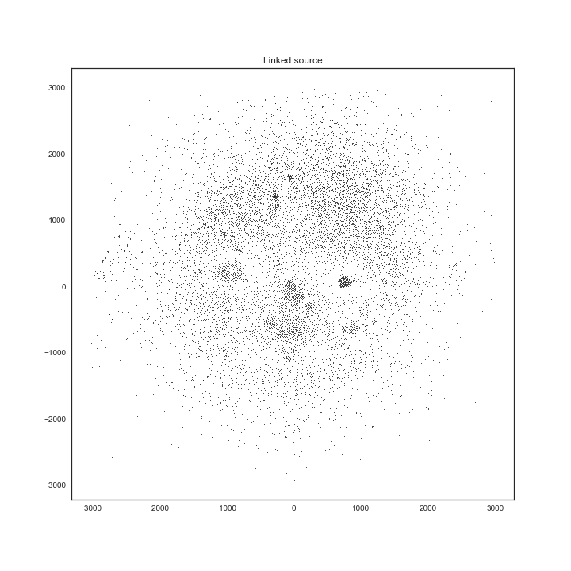

Slide 6
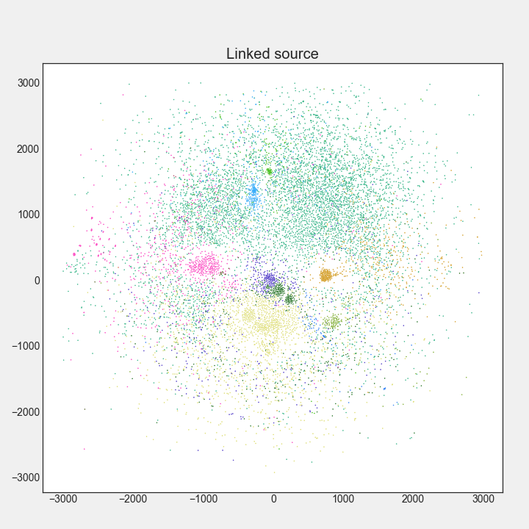
Radio and Organisations (#0)
npr.org / kasu.org / wpsu.org
capradio.org / wsws.org / opb.org
Fast news (#2)
cnn.com / krdo.com / gantdaily.com / wfmz.com abc17news.com / ktvz.com
Hyper connected global US (#4)
msn.com / nydailynews.com foxnews.com / roanoke.com
Global US (#5)
sfgate.com / washingtonpost.com seattletimes.com / chron.com
latimes.com / mysanantonio.com
UK and Ireland (#7)
independent.co.uk / telegraph.co.uk independent.ie / breakingnews.ie
US, Canada and NZ (#1)
chicagotribune.com bostonglobe.com / cbc.ca ctvnews.ca / stuff.co.nz
US East Coast (#8)
indystar.com / app.com / postcrescent.com / news-press.com cincinnati.com

Slide 7
Communities characteristics
Community | #Sources | #Article |  |  | Link weight
 |  | Mean | Median | Std | Mean | Max
#0 | 308 | 42.7 | 23.0 | 44.6 | 21.3 | 284.0
#1 | 1764 | 67.9 | 28.0 | 140.2 | 13.5 | 1151.0
#2 | 828 | 52.6 | 14.0 | 79.0 | 21.9 | 2243.0
#4 | 597 | 143.1 | 22.0 | 273.1 | 93.3 | 5515.0
#5 | 518 | 131.7 | 21.0 | 274.3 | 55.9 | 2244.0
#7 | 480 | 84.1 | 25.0 | 115.0 | 55.8 | 758
#8 | 176 | 39.1 | 22.0 | 37.1 | 22.8 | 240

Slide 8
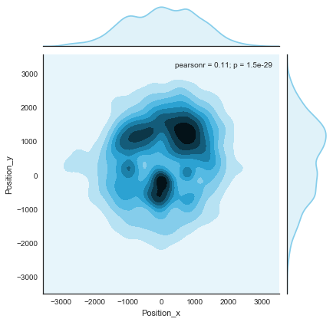
Sources concentration

Slide 9
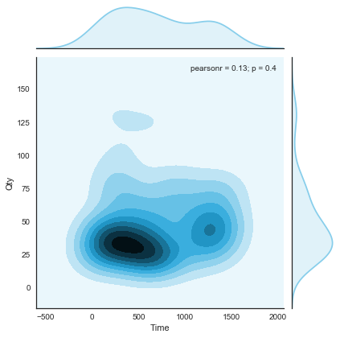
Event
1’462’699 events from all over the world
From 04.12.17 to 12.12.17

Slide 10
The spread of true and false news online, S. Vosoughi, D. Roy and S. Aral
Source : http://science.sciencemag.org/content/359/6380/1146
Data set : rumour cascades on Twitter from 2006 to 2017
Results
Falsehood diffused farther, faster, deeper, and more broadly than the truth
False political news travelled more quickly, deeper and more broadly than other categories of information
Users who spread false news aren’t the influencers

Slide 11
How to find a fake news on website news ?
Sources : www.snopes.com, www.infowars.com, www.theonion.com
Main issues
Fake news are detected quickly after their creation
Fake news are quickly removed or corrected
Some events aren’t in the GDELT Dataset

Slide 12
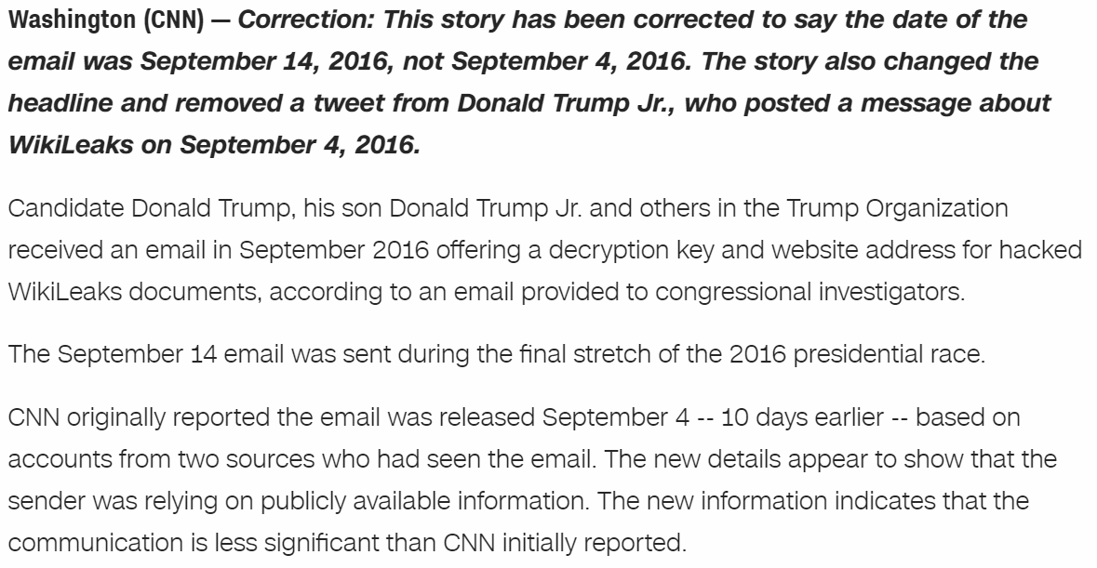
Misinformation
Mention Date | ID | #Articles | #Source
08.12.17 | 713561281.0 | 145 | 132

Slide 13
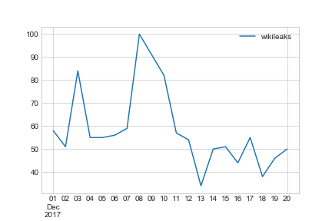
Misinformation

Slide 14
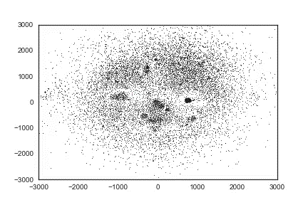
Hyper connected
global US (#4)
Fast News (#2)

Slide 15
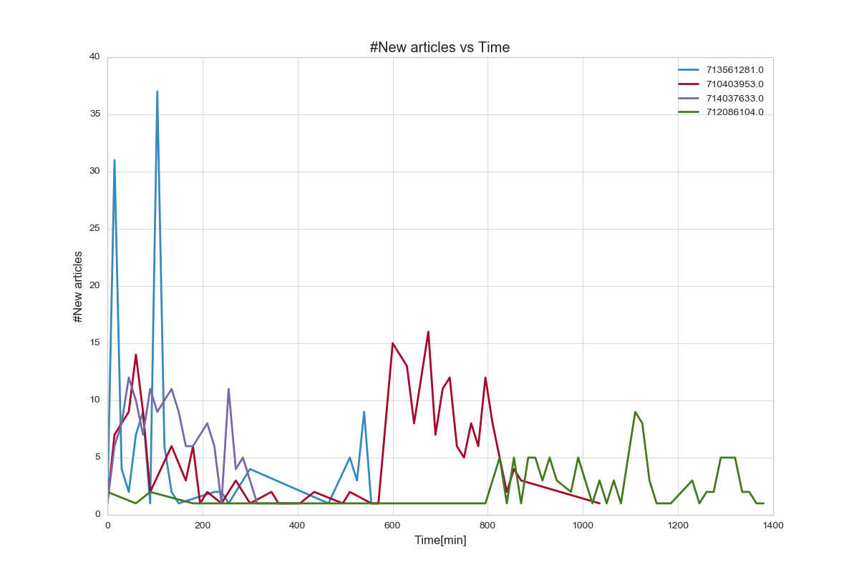
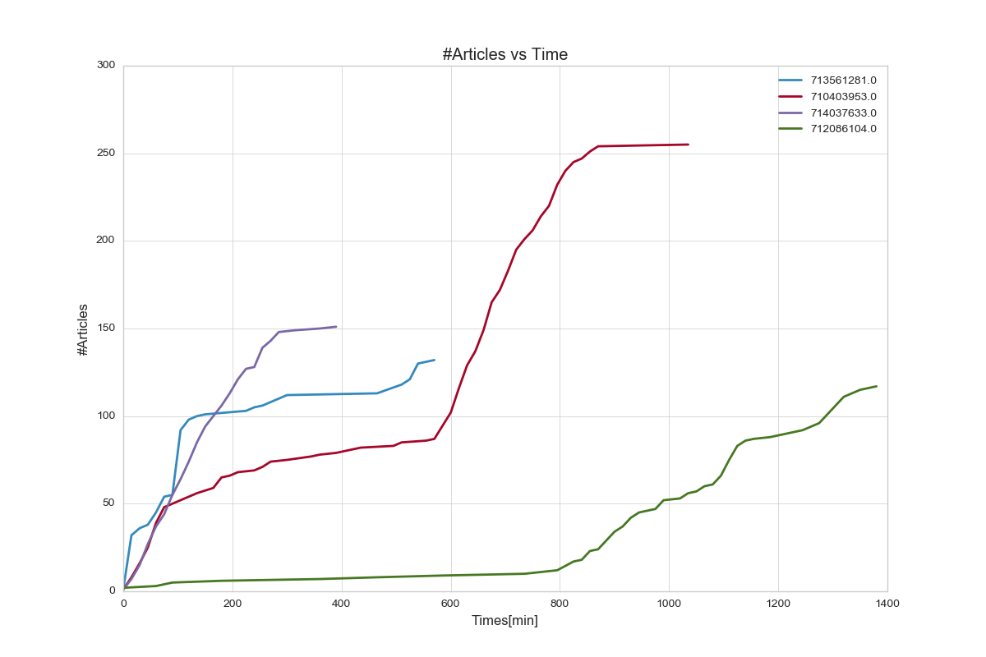

Slide 16
Fake news on the digital press
Sources | Fake news type | Goal | Impact
infowars.com | Conspiracy theory | Destabilization | High
zerohedge.com | Conspiracy theory | Destabilization | High
breitbart.com | Fascism | Indoctrination | High
buzzfeed.com | Buzz | Commercial | Medium - Low
theonion.com | Satire | Amusement | Low

Slide 17
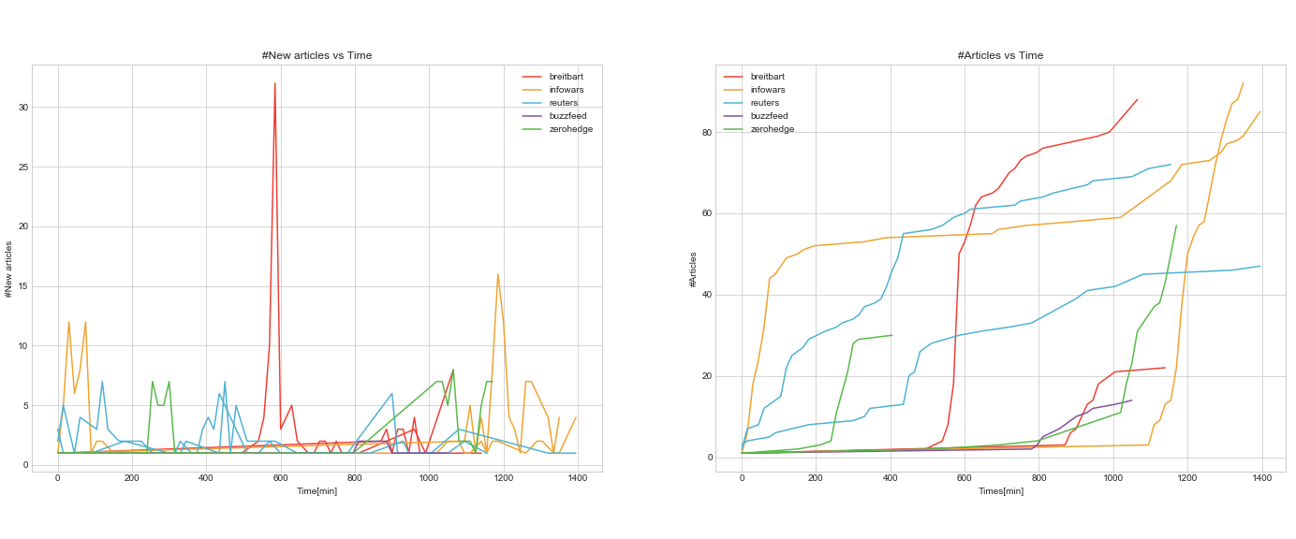
Fake vs Real news

Slide 18
Hypothesis
Fake news characteristics depend on fake news type (conspiracy, buzz, hoax,…)
Conspiracy theory and propaganda spread faster than buzz and hoax news
Fake news are quickly detected by other sources
Real news spreading is more linear than fake news spreading

